Slide 1


Slide 2
Management of Endometrial Cancer
dr Zohreh Yousefi / Fellowship of Gynecology Oncology
Ghaem Hospital, Mashhad University of Medical Sciences

Slide 3
In contrast to cervical cancer, patients with endometrial cancer treated with hysterectomy alone or hysterectomy and radiation do significantly better than those treated with radiation alone
This appears to be related to the inability of radiation therapy effectively to eliminate disease in the myometrium

Slide 4
The cornerstone of treatment for endometrial cancer is
total abdominal hysterectomy and bilateral salpingo-oophorectomy
(Surgical Staging)

Slide 5
Uterine Cancer: Pre-op Evaluation
CA125
Chest X-ray
Mammograms
Colon Evaluation
Others as indicated
Notes:
20% of patients will have elevated Ca 125- a finding that correlates with greater surgical stage
CXR to r/o pulm mets- especially common with sarcomas
Both breast and colon cancer are more common in women with Em Ca and they are more common cancers in general than Em Ca, therefore women with Em Ca should be routinely screened for these diseases, preferably prior to surgical tx for Em Ca

Slide 6
Pre-op imaging
CT –scan
not necessary unless , think there’s extra pelvic disease–
and doesn’t really know of depth of invasion
MRI would be better in assessing invasion

Slide 7
Preoperative preparation
Antimicrobial prophylaxis
DVT prophylaxis
Steep Trendelenburg
Long instruments available
Notes:
So now we're ready to operate.
RememberAntimicrobial prophylaxis
DVT prophylaxis
Steep Trendelenburg is often useful
Long instruments available
The operation is the mainstay of treatment, but also serves to stage the patients disease

Slide 8
Intra-operative Surgical Principals
Availability of frozen section to determine the extent of staging procedure
Capability of complete surgical staging
Capability of tumor reduction if indicated
Notes:
Other surgical principles are as follows:
If we are not certain preoperatively about the need for lymph node sampling we want to be sure to have frozen section available and a pathologist who can accurately evaluate the tumor for grade and depth of invasion as well to rule out as cervical involvement
If extrauterine disease is present we should be prepared to resect it

Slide 9
Complete Surgical Approach
TAH-BSO
peritoneal washings
lymphadenectomy
omental biopsy
Notes:
There is no contoversy that all Grade 3 regardless of depth of invasion
and all deeply invasive tumors regardless of grade, require complete surgical staging

Slide 10
Clinical staging system based on
examination under anesthesia
sounding the uterus
Replaced Clinical Staging 1988
FIGO surgical staging (2008)

Slide 11
Surgical Staging FIGO surgical staging (2008)
Replaced Clinical Staging 1988
Conceptual rationale
  Better defines extent of disease (metastases, depth of invasion, cervix involvement, etc.)
  Minimizes over/under treatment
  Minimally increases perioperative
  morbidity / mortality
  Decreases overall Rx risks and costs
  Better allows comparison of therapeutic results
Notes:
Surgical staging replaced clinical staging in 1989 and has since proved more reliable, more accurate for prognosis and more useful for defining the need for adjuvant therapy than clinical staging.
This is primarily because surgical staging more accurately defines the extent of a patient’s disease with respect to metastases, depth of invasion, cervical involvement, etc.

Slide 12
UTERAIN CORPUS CANCER
Carcinoma of the corpus uteri (FIGO Rio de Janeiro, 1988)
Stage I* | Tumour confined to the corpus uteri.
IA* | Tumor limited to the endometrium.
IB* | Invasion to less than half of the myometrium.
IC* | Invasion equal to or more than half of the myometrium.
Stage II | Extension to the cervix uteri.
IIA* | Endocervical glandular involvement only.
IIB* | Cervical stromal invasion.
Stage III* | Local and/or regional spread of the tumour.
IIIA* | Tumor invades the serosa of the corpus uteri and/or adnexae and/or positive cytological findings.
IIIB* | Vaginal and/or parametrial involvement
IIIC* | Metastases to pelvic and/or para-aortic lymph nodes.
Stage IV* | Tumor invades bladder and/or bowel mucosa, and/or distant metastases.
IVA* | Tumor invasion of bladder and/or bowel mucosa.
IVB* | Distant metastases, including intra-abdominal metastases and/or inguinal lymph nodes.
* Either G1, G2 or G3.
Notes:
12

Slide 13
UTERAIN CORPUS CANCER
Carcinoma of the corpus uteri (FIGO 2008)
Stage I* | Tumour confined to the corpus uteri.
IA* | No or less than half myometrial invasion.
IB* | More than half myometrial invasion.
Stage II* | Tumour invades cervical stroma, but does not extend beyond the uterus.**
Stage III* | Local and/or regional spread of the tumour.
IIIA* | Tumor invades the serosa of the corpus uteri and/or adnexae#.
IIIB* | Vaginal and/or parametrial involvement#.
IIIC* | Metastases to pelvic and/or para-aortic lymph nodes#.
IIIC₁* | Positive pelvic nodes
IIIC₂* | Positive paraortic lymphnodes with or without positive pelvic lymphnodes.
Stage IV* | Tumor invades bladder and/or bowel mucosa, and/or distant metastases.
IVA* | Tumor invasion of bladder and/or bowel mucosa.
IVB* | Distant metastases, including intra-abdominal metastases and/or inguinal lymph nodes.
* Either G1, G2 or G3. ** Endocervical glandular involvement only should be considered as Stage I and no more as Stage II. # Positive cytology has to be reported separately without changing the stage.
Notes:
13

Slide 14
The surgery is as follows:
modified (type II) radical hysterectomy
bilateral salpingo-oophorectomy
peritoneal washings for cytologic study
pelvic lymphadenectomy to the aortic bifurcation
resection of grossly enlarged paraaortic nodes
omental biopsy
biopsy of any suspicious peritoneal nodules

Slide 15
incision allows easy access to the upper abdomen
Pfannenstiel incision is commonly used for patients
with grade 1 or 2 tumors and
a normally sized uterus
50 dL normal saline solution
The uterus is grasped with clamps
that encompass the round

Slide 16
incision is carried anteriorly and posteriorly
retractor in the retroperitoneum
ureter under direct vision
visualized and palpated, and any enlarged nodes and removed
Smead-Jones type Maxon or PDS

Slide 17
The adnexa should be removed because they may be the site of microscopic metastases
In addition, patients with endometrial carcinoma are at increased risk for ovarian cancer

Slide 18
Tumor diameter should also be taken when surgical staging, particularly for grade 2 lesions
incidence of lymph node metastases for grade 2 tumors greater than 2 cm in diamete increase

Slide 19
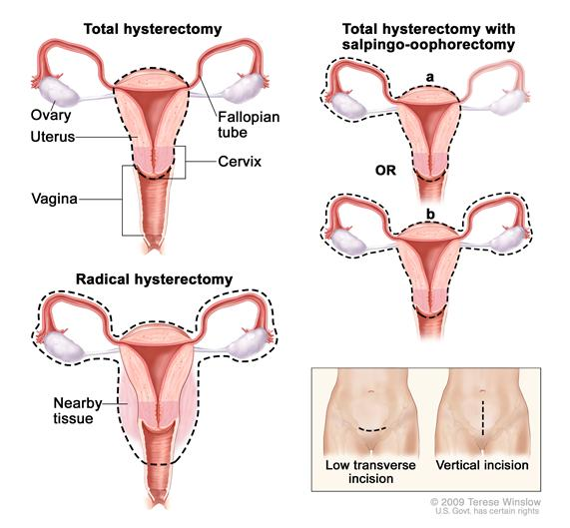

Slide 20
Uterine specimen should be opened after surgery
to evaluate extent of disease
gross inspection of the opened uterus
was a reliable approach
evaluating an accurate
prediction of depth of invasion

Slide 21
Endometrial carcinoma spreads by the following routes:
direct extension to adjacent structures
transtubal passage of exfoliated cells
lymphatic dissemination
hematogenous dissemination
lymphatic channels pass directly from the fundus to the paraaortic nodes through the infundibulopelvic ligament

Slide 22
The decision lymph node sampling surgeon dependent
prognostic features including
tumor grade
depth of invasion
adnexal metastasis
cervical involvement
and positive cytologic findings

Slide 23
it is quite common to find microscopic metastases in both pelvic and paraaortic nodes
suggesting simultaneous spread to pelvic and paraaortic nodes in some patients
This is in contrast to cervical cancer, where paraaortic nodal metastases are always secondary to pelvic nodal metastases

Slide 24
Distribution of pelvic node metastases
in endometrial cancer
Common iliac
Superf.3/15 (20%)
Deep 1/15 (7%)
Presacral
1/15 (7%)
Obturator
Superf.11/15 (73%)
Deep 1/15 (7%)
External iliac
4/15 (27%)
Int J Gynecol Cancer, 1998

Slide 25
Lymphnode Dissection
  All Grade 3
  Any > 50% myometrial invasion
  Any >2 cm tumor diameter
  All Serous/clear cell subtype
  Pre operative assessment of advanced disease (gross cervical or vaginal tumor)
Notes:
There is no contoversy that all Grade 3 regardless of depth of invasion
and all deeply invasive tumors regardless of grade, require complete surgical staging

Slide 26
Pelvic Lymphadenectomy
No preoperative scan is able to detect micrometastases in lymph nodes,
if accurate surgical staging is to be obtained, then full pelvic lymphadenectomy should be performed
on all patients who meet the criteria in
Sampling will only lead to inaccurate information

Slide 27
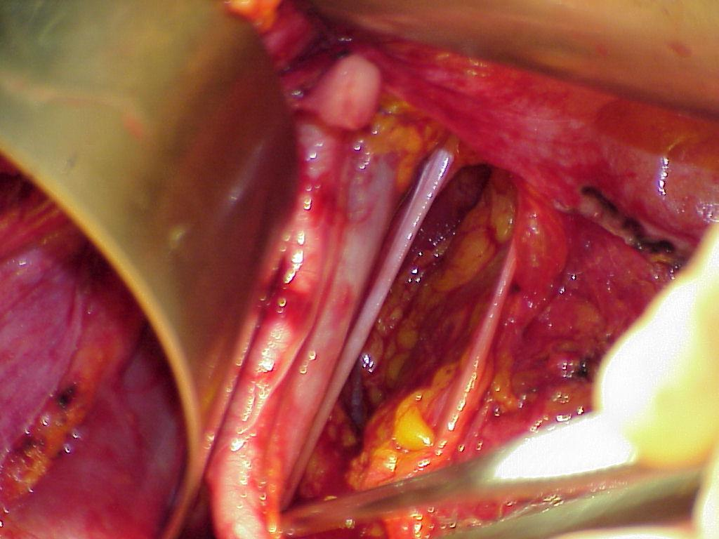
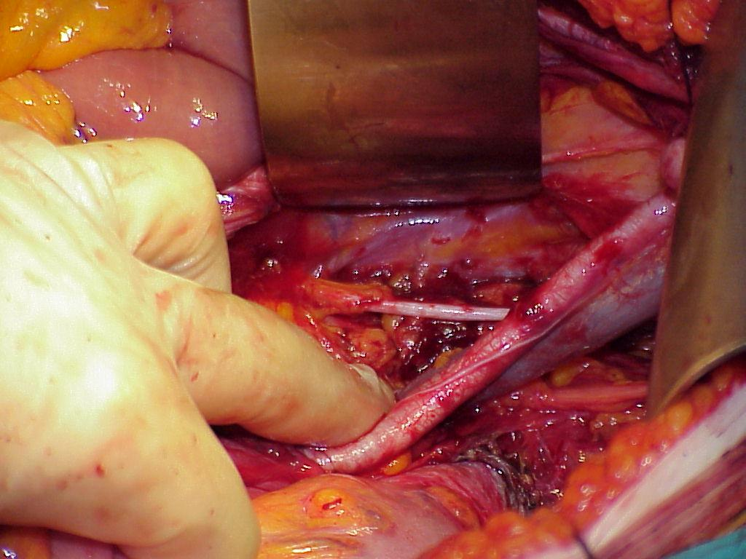
Lymphnode Dissection
Inaccurate LN palpation cannot substitute the histopathology report
Pre-operatory Grading and macroscopic judgement of depth of Myometrial Invasion are not sufficientely predictive of positive lymph nodes
62% of patients with positive pelvic nodes have metastatic para-aortic nodes
Arango et al, Obstet Gynecol 2000; Creasman et al, Cancer 1987

Slide 28
Usually patients are elderly and obese
paraaortic lymphadenectomy significantly increases
operating time
blood loss
increases postoperative morbidity
lower limb lymphedema

Slide 29
The GOG data (63) suggested that patients with positive paraaortic nodes were likely to have:
grossly positive pelvic nodes
grossly positive adnexae
grade 2 or 3 lesions
outer-third myometrial invasion
Negative paraaortic nodes when the
pelvic nodes were negative

Slide 30
The dissection should include
removal of common iliac nodes
and of the fat pad overlying the distal inferior vena cava
full pelvic lymphadenectomy is
considered inadvisable because of the patient's general medical condition

Slide 31
Distribution of aortic node metastases
in endometrial cancer
Intercavo-aortic
7/9 (78%)
Pre-caval
2/9 (22%)
Pre-aortic
2/9 (22%)
Para-caval
3/9 (33%)
Para-aortic
4/9 (44%)
Retro-caval
2/9 (22%)
Retro-aortic
Int J Gynecol Cancer, 1998

Slide 32
resection of any enlarged pelvic nodes should be performed
Can omit LN sampling if risk of lymphnode spread is low

Slide 33
Sentinel node identification
Sentinel node identification has been investigated
the hypothesis being that if one or more sentinel nodes are negative, the remainder of the regional nodes will be negative, so complete lymphadenectomy can be avoided
Lymphatic mapping is performed by infecting tracers around the tumor and identifying the draining node

Slide 34
Three approaches have been used for sentinel node identification in endometrial cancer:
(i) injection into the cervix
(ii) injection around the tumor via a hysteroscope
(iii) injection into the subserosal myometrium at the fundus

Slide 35
patients with low-risk endometrioid endometrial carcinoma
any survival advantage regardless of the
extent of the lymphadenectomy

Slide 36
high-grade cancers
papillary serous carcinoma
clear cell carcinoma
Uterine carcinosarcoma:
Squamous cell carcinoma
undifferentiated carcinomas
grade 3 stages II C or II disease)
All stages II-Iv

Slide 37
Treatment for high-grade cancers:
surgery may be more extensive
In addition to the TH/BSO
and the pelvic and para-aortic lymph node dissections
systematic pelvic lymphadenectomy
at least removal of any clinically suspicious paraaortic lymph nodes
the omentum is often removed

Slide 38
Omental Biopsy
an omental biopsy is also performed as part of the surgical staging because occult omental metastases may occur, particularly in patients
with grade 3 tumors or
deeply invasive lesions
The omentum should be carefully inspected, along with all peritoneal surfaces, and any suspicious lesions excised
If the omentum appears normal, then a generous biopsy (e.g., 5 × 5 cm) should be taken

Slide 39
MANAGEMENT OF STAGE II ENDOMETRIAL CARCINOMA
The surgery would include a radical hysterectomy , (BSO) salpingo- oophorectomy
lymph node dissection (LND) or sampling pelvic and para-aortic

Slide 40
MANAGEMENT OF STAGE III- ENDOMETRIAL CARCINOMA
Stage III cancers have spread outside of the uterus
If the surgeon thinks that all visible cancer can be removed, a hysterectomy with bilateral salpingo-oophorectomy (BSO) is done
A pelvic and para-aortic lymph node dissection may also be done
Pelvic washings will be obtained and
the omentum may be removed

Slide 41
MANAGEMENT OF STAGE IV ENDOMETRIAL CARCINOMA
Make every effort to have patient surgically staged and maximally debulked
Whole abdominal RT alone is probably
an acceptable treatment

Slide 42
Special Clinical Circumstances

Slide 43
Vaginal Hysterectomy
In selected patients with
marked obesity
medical problems that place them at high risk for abdominal operations
vaginal hysterectomy should be considered

Slide 44
Endometrial Carcinomas in Young Women
Approximately 5% of endometrial cancers occur in women aged 40 years
usually in association with
the polycystic ovarian syndrome
usually well-differentiated tumors
minority occur in association with the hereditary nonpolyposis colorectal cancer

Slide 45
MRI to exclude significant myometrial invasion
tumors should have grade 1 histology
and be PR positive
Fertility preservation is concern
with a varietyof progestins
regression of the carcinoma in approximately 80% of cases
recommend hysterectomy once childbearing has been completed

Slide 46
progestin therapy in endometrial hyperplasia
type of progestin
used does
not appear to be important
The main side effects are
weight gain , edema, thrombophlebitis,
and occasionally hypertension.
slightly increased of venous thrombosis

Slide 47
Other approaches to hormonal therapy include
levonorgestrel-releasing intrauterine devices
danazol in a dose of 400 mg daily for 3 months
combined use of gonadotropin-releasing hormone (GnRH) analogues and progestins

Slide 48
younger women
Some time with early endometrial cancer
may have the uterus removed without removing the ovaries
Although this does increase the chance that the recurrence of cancer

Slide 49
When both the cervix and the endometrium
are clinically involved with adenocarcinoma,
may be difficult to distinguish between a stage IB adenocarcinoma of the cervix and
stage II endometrial carcinoma.
Histopathologic evaluation is not helpful
in the differentiation

Slide 50
diagnosis must be based on
clinical and epidemiologic features
The obese, elderly woman with a bulky uterus is more likely to have endometrial cancer
whereas the younger woman with a bulky cervix and a normal corpus is more likely to have cervical cancer

Slide 51
Endometrial Cancer Diagnosed after Hysterectomy
PET or CT scan of the chest , pelvis, and abdomen
a serum CA125 measurement
If all investigations are negative, then approach is as follows
Grade 1 or 2 endometrioid lesions
less than one-half myometrial invasion:
no further treatment
although prophylactic oophorectomy is advisable

Slide 52
high-grade cancers
papillary serous carcinoma
clear cell carcinoma
Uterine carcinosarcoma:
Squamous cell carcinoma
undifferentiated carcinomas
grade 3 stages II C or II disease)
All stages II-Iv

Slide 53
Papillary serous carcinomas
have a poor prognosis even in the absence of deep myometrial invasion or lymph node metastasis
They disseminate widely, with a particular predilection for recurrence in the upper abdomen
The mechanisms to explain include
transtubal spread
vascular-lymphatic invasion
multifocal disease

Slide 54
Clear cell carcinomas
fewer than 5% of endometrial arcinomas
commonly present in papillary serous tumors
Vascular space invasion is more common in these lesions

Slide 55


